Slide 1
Financial Accounting
Weygandt, Kimmel, Kieso
Eleventh Edition
Chapter 2
The Recording Process
This slide deck contains animations. Please disable animations if they cause issues with your device.
©2020 John Wiley & Sons, Inc. All rights reserved.

Slide 2
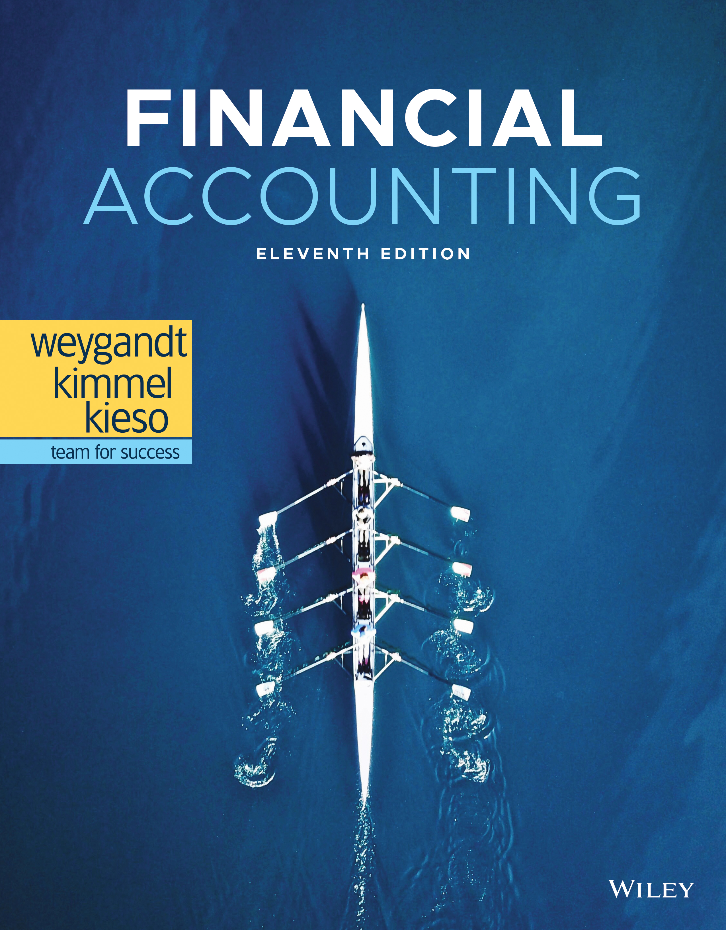
Financial Accounting

Slide 3
The Recording Process
Learning Objectives
L O 1 Describe how accounts, debits, and credits are used to record business transactions.
L O 2 Indicate how a journal is used in the recording process.
L O 3 Explain how a ledger and posting help in the recording process.
L O 4 Prepare a trial balance.

Slide 4
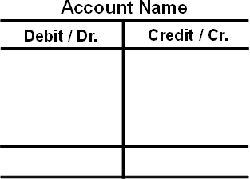
LEARNING OBJECTIVE 1 Describe How Accounts, Debits, and Credits Are Used to Record Business Transactions
Debits and Credits
Record of increases and decreases in a specific asset, liability, stockholders’ equity, revenue, or expense item.
Debit = “Left”
Credit = “Right”
An account can be illustrated in a T-account form.
L O 1

Slide 5
Debits and Credits Double-Entry System
Each transaction must affect two or more accounts to keep the basic accounting equation in balance.
Recording done by debiting at least one account and crediting at least one other account.
Debits must equal Credits.
L O 1

Slide 6
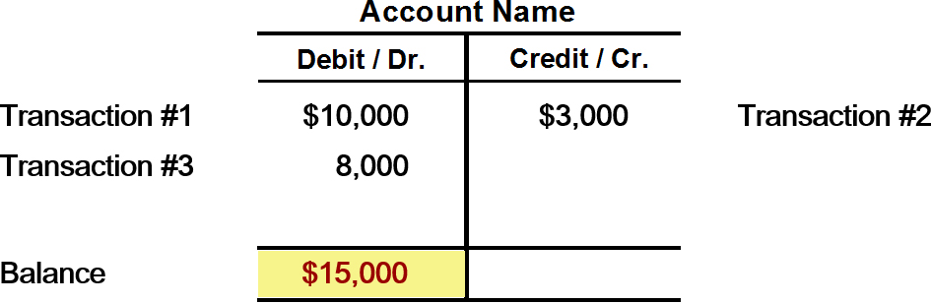
Debits and Credits What Causes a Debit Balance?
If the sum of Debit entries are greater than the sum of Credit entries, the account will have a debit balance.
L O 1

Slide 7
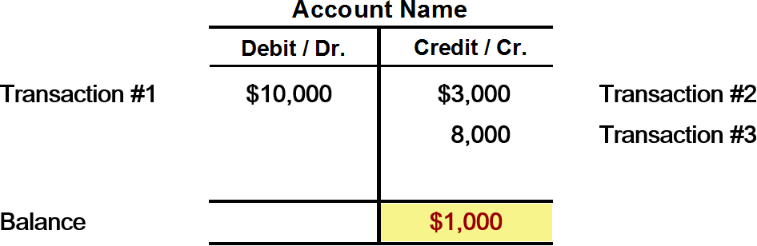
Debits and Credits What Causes a Credit Balance?
If the sum of Credit entries are greater than the sum of Debit entries, the account will have a credit balance.
L O 1

Slide 8
Debits and Credits Asset and Liability Balances
Assets - Debits should exceed credits.
Liabilities – Credits should exceed debits.
Normal balance is on the increased side.
L O 1

Slide 9
Debits and Credits Stockholders’ Equity Balances
Owner’s investments and revenues increase stockholders’ equity (credit).
Dividends and expenses decrease stockholders’ equity (debit).
L O 1

Slide 10
Debits and Credits Revenue and Expense Balances
The purpose of earning revenues is to benefit the stockholders.
The effect of debits and credits on revenue accounts is the same as their effect on stockholders’ equity.
Expenses have the opposite effect: expenses decrease stockholders’ equity.
L O 1

Slide 11
Summary of Debit/Credit Rules
L O 1

Slide 12
Summary of Debit/Credit Rules Question One
Debits:
increase both assets and liabilities.
decrease both assets and liabilities.
increase assets and decrease liabilities.
decrease assets and increase liabilities.
L O 1

Slide 13
Summary of Debit/Credit Rules Answer One
Debits:
increase both assets and liabilities.
decrease both assets and liabilities.
Answer: increase assets and decrease liabilities.
decrease assets and increase liabilities.
L O 1

Slide 14
Summary of Debit/Credit Rules Question Two
Accounts that normally have debit balances are:
assets, expenses, and revenues.
assets, expenses, and equity.
assets, liabilities, and dividends.
assets, dividends, and expenses.
L O 1

Slide 15
Summary of Debit/Credit Rules Answer Two
Accounts that normally have debit balances are:
assets, expenses, and revenues.
assets, expenses, and equity.
assets, liabilities, and dividends.
Answer: assets, dividends, and expenses.
L O 1

Slide 16
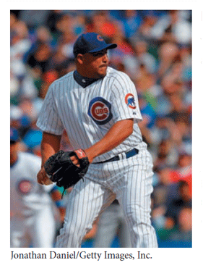
Investor Insight Chicago Cubs
Keeping Score
The Chicago Cubs baseball team probably has these major revenue and expense accounts:
Revenues | Expenses
Admissions (ticket sales) | Players’ salaries
Concessions | Administrative salaries
Television and radio | Travel
Advertising | Ballpark maintenance
L O 1

Slide 17
Investor Insight Chicago Cubs (Question and Answer)
Keeping Score
Do you think that the Chicago Bears football team would be likely to have the same major revenue and expense accounts as the Cubs?
Answer:
Because their businesses are similar—professional sports—many of the revenue and expense accounts for the baseball and football teams might be similar.
L O 1

Slide 18
Stockholders’ Equity Relationships
L O 1

Slide 19
Debit/Credit Rules and the Accounting Equation
Relationship among the assets, liabilities and stockholders’ equity of a business:
The equation must be in balance after every transaction. Total Debits must equal total Credits.
L O 1

Slide 20
DO IT! 1: Normal Account Balances
Kate Browne, president of Hair It Is, Inc., has just rented space in a shopping mall in which she will open and operate a beauty salon. A friend has advised Kate to set up a double-entry set of accounting records in which to record all of her business transactions.
Identify the balance sheet accounts that Hair It Is, Inc. will likely use to record the transactions needed to establish and open the business. Also, indicate whether the normal balance of each account is a debit or a credit.
Assets
Cash (debit)
Supplies (debit)
Equipment (debit)
Liabilities
Notes Payable (credit)
Accounts Payable (credit)
Equity
Common Stock (credit)
L O 1

Slide 21
LEARNING OBJECTIVE 2 Indicate How a Journal Is Used in the Recording Process
The Recording Process
L O 2

Slide 22
The Recording Process The Journal
Book of original entry.
Transactions recorded in chronological order.
Contributions to the recording process:
Discloses in one place the complete effects of a transaction.
Provides a chronological record of transactions.
Helps to prevent or locate errors because the debit and credit amounts can be easily compared.
L O 2

Slide 23
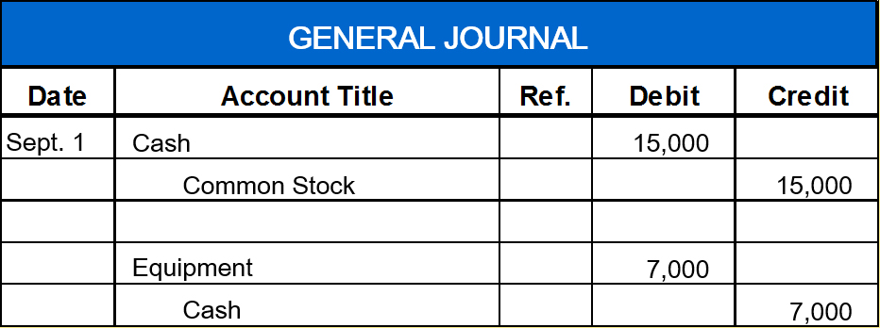
The Recording Process Journal Entry Illustration
Journalizing - Entering transaction data in the journal.
Illustration: On September 1, stockholders invested $15,000 cash in Softbyte Inc. in exchange for common stock, and Softbyte purchased computer equipment for $7,000 cash.
L O 2

Slide 24
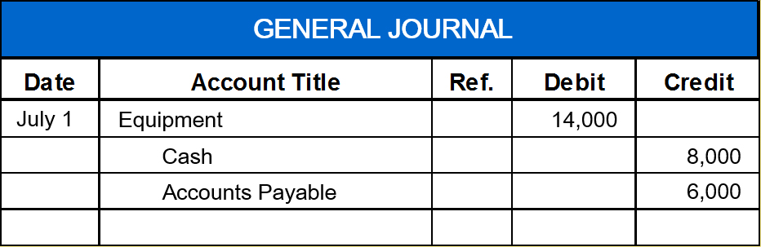
The Recording Process Compound Entry
Illustration: On July 1, Butler Company purchases a delivery truck costing $14,000. It pays $8,000 cash now and agrees to pay the remaining $6,000 on account.
L O 2

Slide 25
DO IT! 2: Recording Business Activities Journal Entries
As president and sole stockholder, Kate Browne engaged in the following activities in establishing her salon, Hair It Is, Inc.:
Opened a bank account in the name of Hair It Is, Inc. and deposited $20,000 of her own money in this account in exchange for shares of common stock.
Purchased equipment on account (to be paid in 30 days) for a total cost of $4,800.
Interviewed three people for the position of hair stylist.
Prepare the entries to record the transactions.
L O 2

Slide 26
DO IT! 2: Recording Business Activities Solution
Prepare the entries to record the transactions.
Opened a bank account and deposited $20,000.
Cash | 20,000
Common Stock | 20,000
Purchased equipment on account (to be paid in 30 days) for a total cost of $4,800.
Equipment | 4,800
Accounts Payable | 4,800
Interviewed three people for the position of hair stylist.
No entry
L O 2

Slide 27
LEARNING OBJECTIVE 3 Explain How a Ledger and Posting Help in the Recording Process
The Ledger
L O 3

Slide 28
The Ledger
Three-Column Form of Account
L O 3

Slide 29
Ethics Insight Credit Suisse Group
A Convenient Overstatement
Sometimes a company’s investment securities suffer a permanent decline in value below their original cost. When this occurs, the company is supposed to reduce the recorded value of the securities on its balance sheet (“write them down” in common financial lingo) and record a loss. It appears, however, that during the financial crisis of 2008, employees at some financial institutions chose to look the other way as the value of their investments skidded.
A number of Wall Street traders that worked for the investment bank Credit Suisse Group were charged with intentionally overstating the value of securities that had suffered declines of approximately $2.85 billion. One reason that they may have been reluctant to record the losses is out of fear that the company’s shareholders and clients would panic if they saw the magnitude of the losses. However, personal self-interest might have been equally to blame—the bonuses of the traders were tied to the value of the investment securities.
Source: S. Pulliam, J. Eaglesham, and M. Siconolfi, “U.S. Plans Changes on Bond Fraud,” Wall Street Journal Online (February 1, 2012).
L O 3

Slide 30
Ethics Insight Credit Suisse Group (Question and Answer)
A Convenient Overstatement
What incentives might employees have had to overstate the value of these investment securities on the company’s financial statements?
Answer:
One reason that they may have been reluctant to record the losses is out of fear that the company's shareholders and clients would panic if they saw the magnitude of the losses. However, personal self-interest might have been equally to blame—the bonuses of the traders were tied to the value of the investment securities.
L O 3

Slide 31
Posting
Posting a journal entry.
L O 3

Slide 32
Posting Question
Posting:
normally occurs before journalizing.
transfers ledger transaction data to the journal.
is an optional step in the recording process.
transfers journal entries to ledger accounts.
L O 3

Slide 33
Posting Answer
Posting:
normally occurs before journalizing.
transfers ledger transaction data to the journal.
is an optional step in the recording process.
Answer: transfers journal entries to ledger accounts.
L O 3

Slide 34
Chart of Accounts
L O 3

Slide 35
The Recording Process Illustrated Investment of Cash by Stockholders
Follow these steps:
Determine what type of account is involved.
Determine what items increased or decreased and by how much.
Translate the increases and decreases into debits and credits.
L O 3

Slide 36
The Recording Process Illustrated Purchase of Office Equipment
L O 3

Slide 37
The Recording Process Illustrated Receipt of Cash for Future Service
L O 3

Slide 38
The Recording Process Illustrated Payment of Monthly Rent
L O 3

Slide 39
The Recording Process Illustrated Payment of Insurance
L O 3

Slide 40
The Recording Process Illustrated Purchase of Supplies on Credit
L O 3

Slide 41
The Recording Process Illustrated Hiring of Employees
L O 3

Slide 42
The Recording Process Illustrated Receipt of Cash for Services Performed
L O 3

Slide 43
The Recording Process Illustrated Payment of Salaries
L O 3

Slide 44
The Recording Process Illustrated Declaration and Payment of Dividend
L O 3

Slide 45
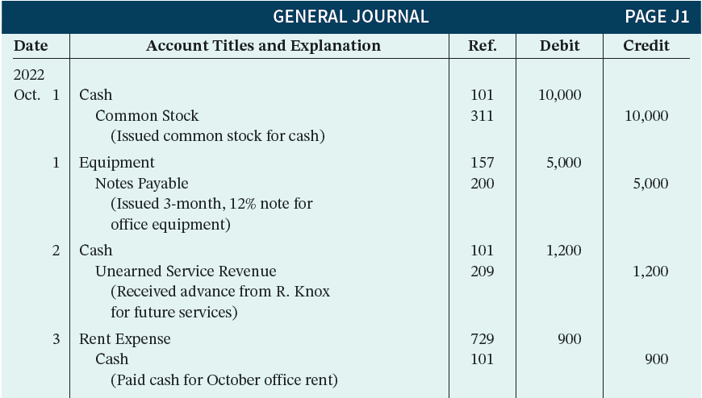
Summary Journalizing and Posting Oct. 1-3
L O 3

Slide 46
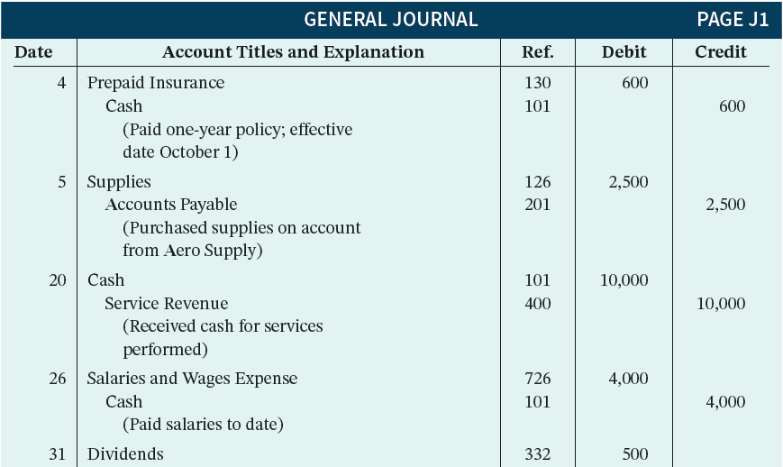
Summary Journalizing and Posting Oct. 4-31
L O 3

Slide 47
General Ledger Illustrated
L O 3

Slide 48
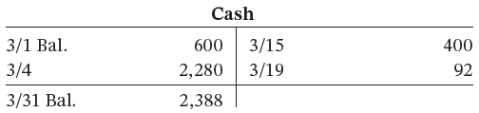
DO IT! 3: Posting
Kate Browne recorded the following transactions in a general journal during the month of March. Post these entries to the Cash account. The beginning balance of Cash on March 1 was $600.
Mar. | 4 | Cash | 2,280
 |  | Service Revenue |  | 2,280
 | 15 | Salaries and Wages Expense | 400
 |  | Cash |  | 400
 | 19 | Utilities Expense | 92
 |  | Cash |  | 92
L O 3

Slide 49
L O 4: Prepare a Trial Balance
L O 3

Slide 50
Limitations of a Trial Balance
Trial balance may balance even when:
A transaction is not journalized.
A correct journal entry is not posted.
A journal entry is posted twice.
Incorrect accounts are used in journalizing or posting.
Offsetting errors are made in recording the amount of a transaction.
Ethics note: An error is the result of an unintentional mistake; it is neither ethical or unethical. An irregularity is an intentional misstatement, which is viewed as unethical.
L O 3

Slide 51
Dollar Signs and Underlining
Dollar Signs
Do not appear in journals or ledgers.
Typically used only in the trial balance and the financial statements.
Shown only for the first item in the column and for the total of that column.
Underlining
A single line is placed under the column of figures to be added or subtracted.
Totals are double-underlined.
L O 3

Slide 52
Trial Balance Question
A trial balance will not balance if:
a correct journal entry is posted twice.
the purchase of supplies on account is debited to Supplies and credited to Cash.
a $100 cash dividend by the owner is debited to Dividends for $1,000 and credited to Cash for $100.
a $450 payment on account is debited to Accounts Payable for $45 and credited to Cash for $45.
L O 3

Slide 53
Trial Balance Answer
A trial balance will not balance if:
a correct journal entry is posted twice.
the purchase of supplies on account is debited to Supplies and credited to Cash.
Answer: a $100 cash withdrawal by the owner is debited to Dividends for $1,000 and credited to Cash for $100.
a $450 payment on account is debited to Accounts Payable for $45 and credited to Cash for $45.
L O 3

Slide 54
Investor Insight Fannie Mae
Why Accuracy Matters
While most companies record transactions very carefully, the reality is that mistakes still happen. For example, bank regulators fined Bank One Corporation (now JPMorgan Chase) $1.8 million because they felt that the unreliability of the bank’s accounting system caused it to violate regulatory requirements.
Also, in recent years Fannie Mae, the government-chartered mortgage association, announced a series of large accounting errors. These announcements caused alarm among investors, regulators, and politicians because they fear that the errors may suggest larger, undetected problems. This is important because the home-mortgage market depends on Fannie Mae to buy hundreds of billions of dollars of mortgages each year from banks, thus enabling the banks to issue new mortgages.
Finally, before a major overhaul of its accounting system, the financial records of Waste Management, Inc. were in such disarray that of the company’s 57,000 employees, 10,000 were receiving pay slips that were in error.
The Sarbanes-Oxley Act was created to minimize the occurrence of errors like these by increasing every employee’s responsibility for accurate financial reporting.
L O 3

Slide 55
Investor Insight Fannie Mae (Question and Answer)
Why Accuracy Matters
In order for these companies to prepare and issue financial statements, their accounting equations (debits and credits) must have been in balance at year-end. How could these errors or misstatements have occurred?
Answer:
A company's accounting equation (its books) can be in balance yet its financial statements have errors or misstatements because of the following: entire transactions were not recorded; transactions were recorded at wrong amounts; transactions were recorded in the wrong accounts; transactions were recorded in the wrong accounting period. Audits of financial statements uncover some but obviously not all errors or misstatements.
L O 3

Slide 56
DO IT! 4: Trial Balance Information Needed
The following accounts come from the ledger of SnowGo Corporation at December 31, 2022.
157 | Equipment | $88,000
332 | Dividends | 8,000
201 | Accounts Payable | 22,000
726 | Salaries and Wages Expense | 42,000
112 | Accounts Receivable | 4,000
400 | Service Revenue | 95,000
311 | Common Stock | $20,000
212 | Salaries and Wages Payable | 2,000
200 | Notes Payable (due in 3 months) | 19,000
732 | Utilities Expense | 3,000
130 | Prepaid Insurance | 6,000
101 | Cash | 7,000
Prepare a trial balance in good form.
L O 4

Slide 57
DO IT! 4: Trial Balance Solution
L O 4

Slide 58
A Look at I F R S Similarities
L O 5 Compare the procedures for the accounting process under G A A P and I F R S.
Key Points
Similarities
Transaction analysis is the same under I F R S and G A A P.
Both the I A S B and the F A S B go beyond the basic definitions provided in the text for the key elements of financial statements, that is assets, liabilities, equity, revenues, and expenses. The implications of the expanded definitions are discussed in more advanced accounting courses.
L O 5

Slide 59
A Look at I F R S More Similarities
Key Points
More Similarities
As shown in the text, dollar signs are typically used only in the trial balance and the financial statements. The same practice is followed under I F R S, using the currency of the country where the reporting company is headquartered.
A trial balance under I F R S follows the same format as shown in the text.
L O 5

Slide 60
A Look at I F R S Differences
Key Points
Differences
I F R S relies less on historical cost and more on fair value than do F A S B standards.
Internal controls are a system of checks and balances designed to prevent and detect fraud and errors. While most public U.S. companies have these systems in place, many non-U.S. companies have never completely documented the controls nor had an independent auditor attest to their effectiveness.
L O 5

Slide 61
A Look at I F R S Which is Correct? Question
I F R S Self-Test Questions
Which statement is correct regarding I F R S?
I F R S reverses the rules of debits and credits, that is, debits are on the right and credits are on the left.
I F R S uses the same process for recording transactions as G A A P.
The chart of accounts under I F R S is different because revenues follow assets.
None of the above statements are correct.
L O 5

Slide 62
A Look at I F R S Which is Correct? Answer
I F R S Self-Test Questions
Which statement is correct regarding I F R S?
I F R S reverses the rules of debits and credits, that is, debits are on the right and credits are on the left.
Answer: I F R S uses the same process for recording transactions as G A A P.
The chart of accounts under I F R S is different because revenues follow assets.
None of the above statements are correct.
L O 5

Slide 63
A Look at I F R S Trial Balance Question
I F R S Self-Test Questions
A trial balance:
is the same under I F R S and G A A P.
proves that transactions are recorded correctly.
proves that all transactions have been recorded.
will not balance if a correct journal entry is posted twice.
L O 5

Slide 64
A Look at I F R S Trial Balance Answer
I F R S Self-Test Questions
A trial balance:
Answer: is the same under I F R S and G A A P.
proves that transactions are recorded correctly.
proves that all transactions have been recorded.
will not balance if a correct journal entry is posted twice.
L O 5

Slide 65
A Look at I F R S Difference Question
I F R S Self-Test Questions
One difference between I F R S and G A A P is that:
G A A P uses accrual-accounting concepts and I F R S uses primarily the cash basis of accounting.
I F R S uses a different posting process than G A A P.
I F R S uses more fair value measurements than G A A P.
the limitations of a trial balance are different between I F R S and G A A P.
L O 5

Slide 66
A Look at I F R S Difference Answer
I F R S Self-Test Questions
One difference between I F R S and G A A P is that:
G A A P uses accrual-accounting concepts and I F R S uses primarily the cash basis of accounting.
I F R S uses a different posting process than G A A P.
Answer: I F R S uses more fair value measurements than G A A P.
the limitations of a trial balance are different between I F R S and G A A P.
L O 5

Slide 67
Copyright
©2020 John Wiley & Sons, Inc. All rights reserved.
No part of this publication may be reproduced, stored in a retrieval system, or transmitted, in any form or by any means, electronic, mechanical, photocopying, recording or otherwise, except as permitted by law. Advice on how to obtain permission to reuse this material is available at http://www.wiley.com/go/permissions.

